Slide 1
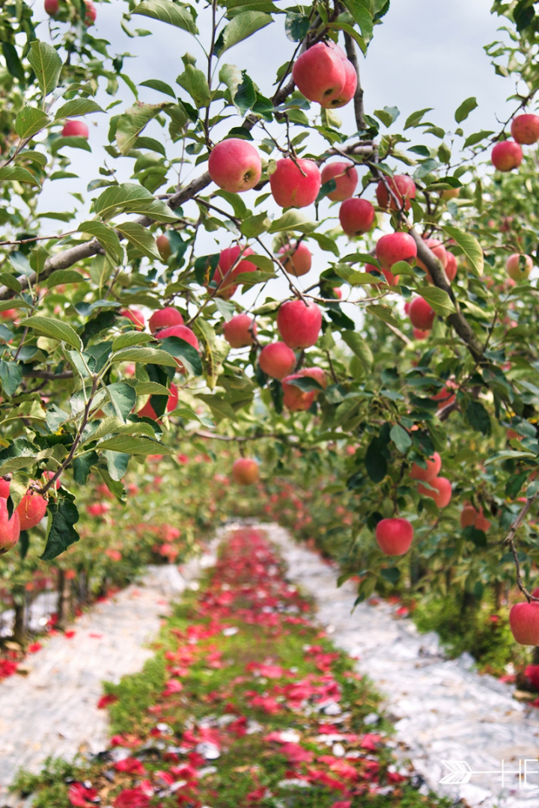
Introduction of Orchard Management Package in Python

Slide 2
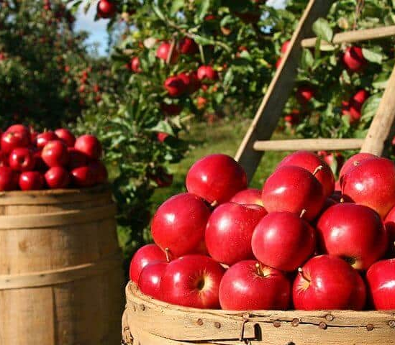

Orchard Management
This orchard management app is designed for orchard staff to store and display product information, estimate and control inventory, and manage their business orders.
Package: Orchard Management
Subpackage 1: production
Subpackage 2: inventory and sales.

Slide 3

Package: product
Module: fruit
Module “fruit” is designed to store and manage information about the types of crops in the orchard.
Class: fruit
Variety
Features
Price
Subclasses of fruit:
Different variety allowed and harvest seasons
Apple
Cherry
Peach

Slide 4

Fruit: Function
Fruit introduction
Introduction the types, variety and characteristics of fruits grown in orchard
Fruit seasonality check
Check if a specific fruit is in season based on the input month.
Check and identify all fruits that are currently in season.
Fruit price calculation
Calculate the total price of a selection of fruit based on its individual price, quantities, and discount (marketing sell only)
Fruit information store
Store all fruit categories and information into a file for convenient retrieval.

Slide 5
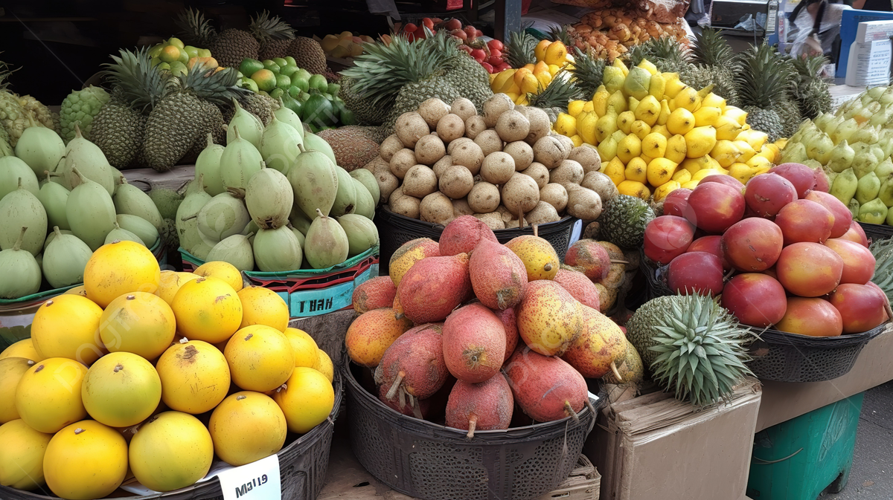
Package: product
Module: plantation
Module plantation is designed to allocated lands for multiple kind of fruit trees.
We divide the whole plantation into areas of varying size, and plant different crop varieties on them.
Class: region
- fruit
- area
- area type
Two type of region:
We are dividing the regions into two distinct set: Some for visitor to pick by themselves and others for large-scale wholesale.
- picking plantation
- marketing planation

Slide 6

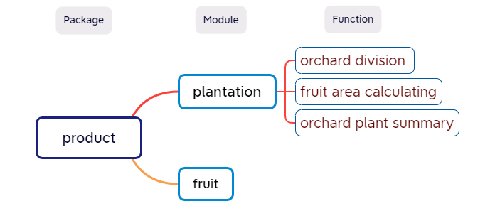
plantation: Function
Orchard division
Organizing the entire plantation into distinct regions for fruit cultivation. And divide
them into two different type: picking and marketing.
Fruit area calculating
Calculate the total cultivation area of a specific plant.
Orchard plantation summary
Provide a summary about detailing various planting regions and fruit varieties within the orchard. It returns as a summary which intended for estimating the fruit yield.

Slide 7
Subpackage:
Inventory and sales
Notes:
Let me introduce the second subpackage, which is inventory and sales

Slide 8
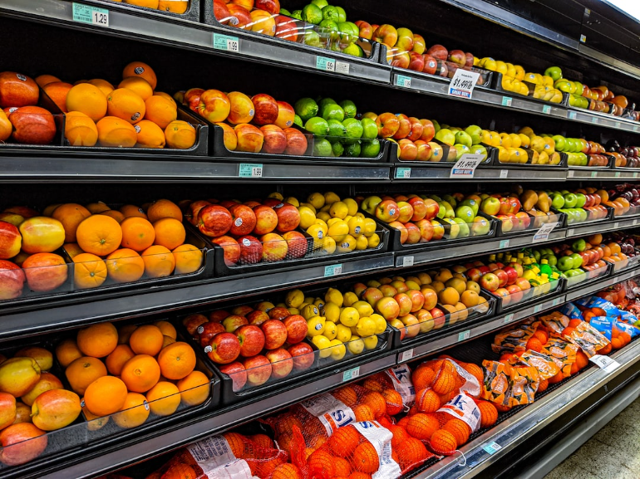
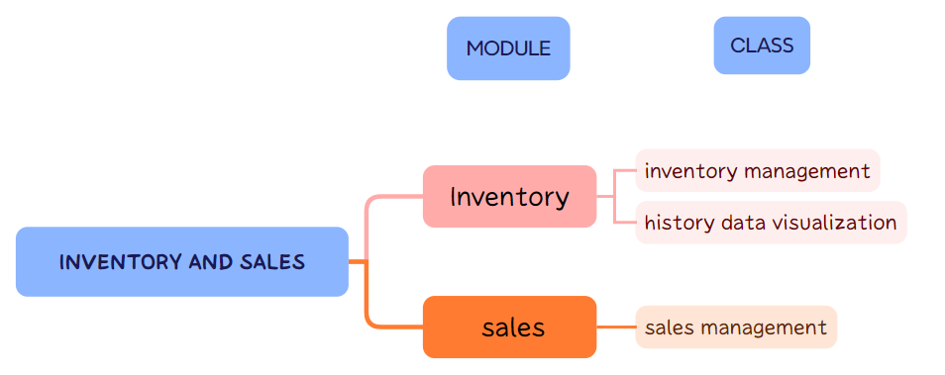
Module 1 : Inventory
This module is designed for basic orchard inventory management. It contains two classes: InventoryManagement and Visualization.
InventoryManagement
This class is responsible for managing the current inventory status and forecasting the remaining yield (unharvested).
Visualization
This class is used for simple visualization of historical data.
Notes:
The first module is inventory, this module is designed for basic orchard inventory management. It contains two classes: InventoryManagement and Visualization.
Inventory management is responsible for managing the current inventory status and forcasting the remaining yield, which is unharvested.
Visualization class is used for simple visualization of historical data

Slide 9

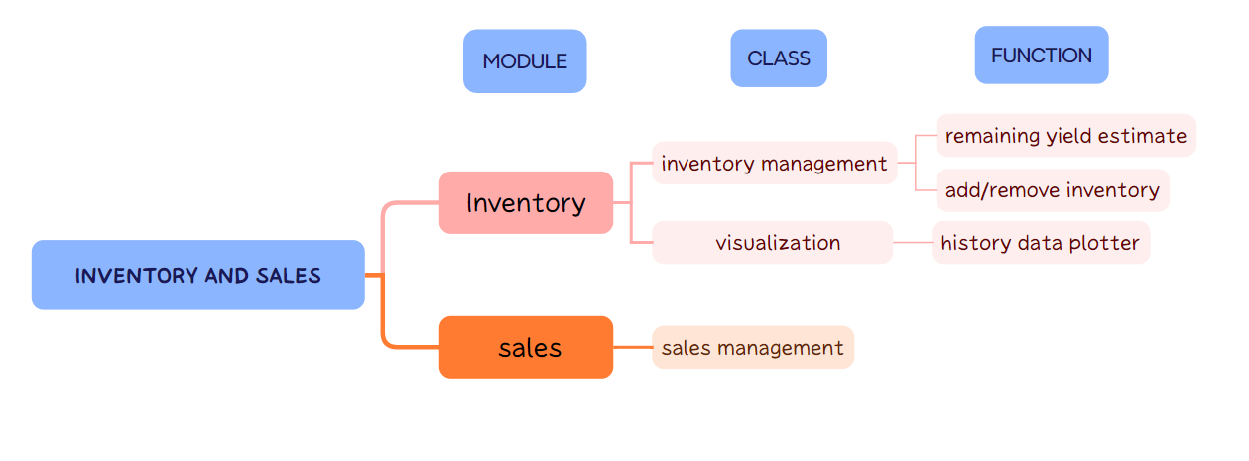
Inventory : Functions
Three main functions revolve around inventory and visualization:
Remaining_Yield_Estimation
Calculates the expected yield for each variety based on the planting area in the first subpackage. And create a file to record the remaining capacity. An auxiliary method save_overdraft, will record the production output that exceeds the expected yield.
Add/Remove_Inventory
Add/Remove_Inventory: Used to increase or decrease inventory, with data being stored in an inventory data file. This involves auxiliary functions such as Load/Save_data and Current_inventory_display.
History_Data_Plotter
Draws a plot illustrating changes in inventory over time.
Notes:
There are 3 main functions in inventory module
The first one is remaining_yield_estimation.
Which Calculates the expected yield for each variety based on the planting area in the first subpackage. And create a file to record the remaining capacity.
An auxiliary method save_overdraft, will record the production output that exceeds the expected yield.
The second one is add inventory and remove inventory, they are used to increase or decrease inventory, with data being stored in an inventory data file. This involves auxiliary functions such as Load/Save_data and Current_inventory_display.
And History_Data_Plotter
Is used to Draws a plot illustrating changes in inventory over time.

Slide 10
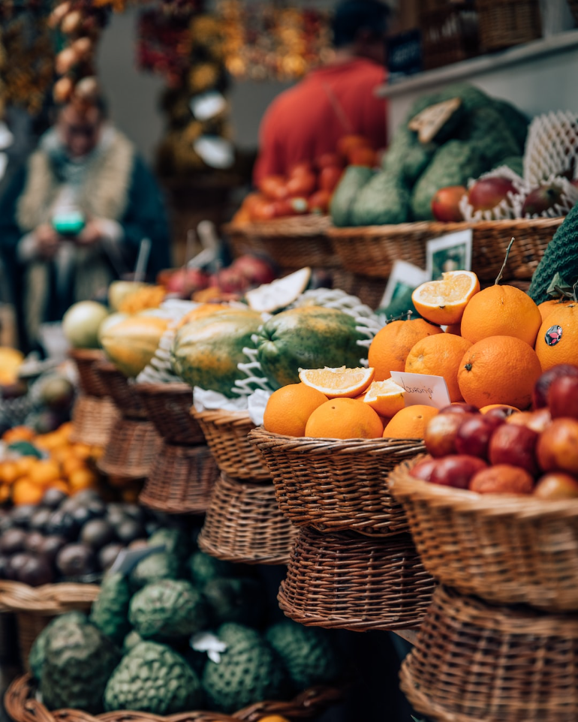
Module 2 : Sales
This module is designed to manage order situations and includes a class called Sales Management.
It handles different processes for sales, generates alerts when insufficient capacity, keeps track of historical orders, and performs basic revenue calculations.
Notes:
The second module is sales. Which is designed to manage order situations and includes a class called Sales Management.
It handles different processes for sales, generates alerts when insufficient capacity, keeps track of historical orders, and performs basic revenue calculations.

Slide 11

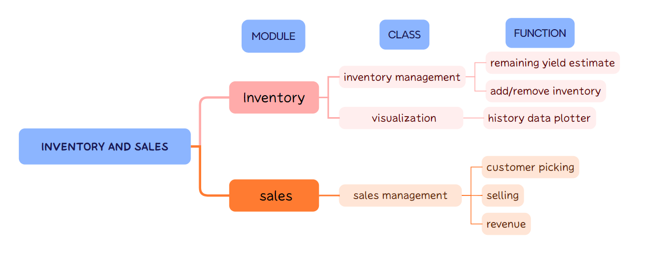
Sales : Functions
Three functions primarily manage sales situations, interacting with functions in the inventory module to record inventory and remaining capacity changes.
Customer_Picking
Records customer picking situations, only change remaining yield capacity without affecting warehouse inventory.
Selling
Records instances of direct customer purchases, modifying inventory data. Generate alert information when inventory or remaining capacity is not enough.
Orders and revenue
Records different orders and display revenue (costs are not considered in this context).
Notes:
There are Three main functions in this module primarily manage sales situations, interacting with functions in the inventory module to record inventory changes.
The first function is customer_picking which Records customer picking situations, it only changes remaining yield capacity without affecting warehouse inventory.
The second function is selling which Records direct customer purchases, modifying inventory data. Generate alert information when inventory or remaining capacity is not enough.
In order and revenue function they Record different orders and display revenue , and costs are not considered in this context.

Slide 12
Thank you for your time!
Notes:
That’s all, and thank you for your time.

